Slide 1
WATER POLLUTION AND ITS MANAGEMENT UNIT III 18CEO405T

Slide 2
MITIGATION MEASURES FOR WATER POLLUTION CONTAMINATION DUE TO INDUSTRIES
Mitigation aims at preventing adverse impacts from happening and keeping those that do occur within acceptable levels.
Aims of Mitigation:
Developing measures to avoid, reduce, remedy or compensate significant adverse impacts of development proposals on environment and society;
Enhancing beneficial effects and lower costs for environmental protection and conservation of natural resources as an outcome of development where possible;
Fostering better opportunities for business through positive outcomes for environmental conservation, sustainable livelihoods and human well being

Slide 3
MITIGATION MEASURES FOR WATER POLLUTION CONTAMINATION DUE TO INDUSTRIES
Conjunctive use of ground/surface water, to prevent flooding/water logging/depletion of water resources. Included are land use pattern, land filling, lagoon/reservoir/garland canal construction, and rainwater harvesting and pumping rate.
Stormwater drainage system to collect surface runoff
Minimise flow variation from the mean flow ✓
Storing of oil wastes in lagoons should be minimised in order to avoid possible contamination of the ground water system.
All effluents containing acid/alkali/organic/toxic wastes should be properly treated.
Monitoring of ground waters
Use of biodegradable or otherwise readily treatable additives

Slide 4
MITIGATION MEASURES FOR WATER POLLUTION CONTAMINATION DUE TO INDUSTRIES
Neutralization and sedimentation of wastewaters, where applicable
Dewatering of sludges and appropriate disposal of solids
In case of oil waste, oil separation before treatment and discharge into the environment
By controlling discharge of sanitary sewage and industrial waste into the environment
By avoiding the activities that increases erosion or that contributes nutrients to water (thus stimulating alga growth)
For wastes containing high TDS, treatment methods include removal of liquid and disposal of residue by controlled landfilling to avoid any possible leaching of the fills
All surface runoffs around mines or quarries should be collected treated and disposed.
Treated wastewater (such as sewage, industrial wastes, or stored surface runoffs) can be used as cooling water makeup.

Slide 5
MITIGATION MEASURES FOR WATER POLLUTION CONTAMINATION DUE TO INDUSTRIES
Wastewater carrying radioactive elements should be treated separately by means of dewatering procedures, and solids or brine should be disposed of with special care.
Develop spill prevention plans in case of chemical discharges and spills
Develop traps and containment system and chemically treat discharges on site

Slide 6
TREATMENT OF INDUSTRIAL WASTE WATER
Conventional mechanical wastewater treatment is a combination of physical and biological processes designed to remove organic matter and solids from solution.
In the current trend, Primary sedimentation and sludge processing are performed in separate treatment tanks.
Primary sedimentation of municipal wastewater has limited effectiveness, since less than half of the wastewater organic content is typically settleable.
Advanced primary treatment involved chemical coagulation at the primary clarifier to improve settleability of the wastes. Although this is provided considerable improvement, the heavy chemical dosages resulted in high cost, and dissolved organics were still not removed.
The first major breakthrough in secondary treatment occurred when it was observed that the slow movement of wastewater through a gravel bed resulted in rapid reduction of organic matter and BOD.

Slide 7
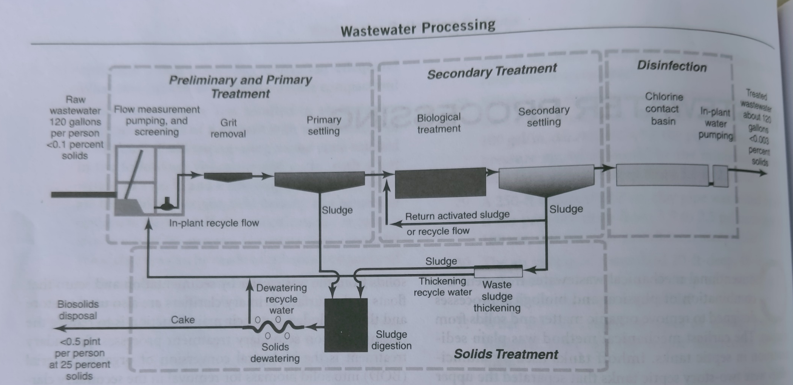
TREATMENT OF INDUSTRIAL WASTE WATER

Slide 8
TREATMENT OF INDUSTRIAL WASTE WATER
Diagram summarize the processes applied in conventional municipal wastewater treatment.
Preliminary steps include influent flow measurement, screening to protect the pumps from large solids, pumping as needed to lift the wastewater above ground level, and grit removal to protect mechanical equipment from abrasive wear.
Primary treatment removes heavier solids from the wastewater by sedimentation and scum that floats to the surface.
Primary clarifiers are also used to store and thicken sludge, but their main function is to reduce the organic load on secondary treatment processes.

Slide 9
TREATMENT OF INDUSTRIAL WASTE WATER
Secondary treatment is the biological conversion of organic material into solid biomass for removal in the secondary clarifiers.
Following secondary settling, disinfection of the effluent reduces the risk of disease and biological activity for use in-plant , irrigation, or as required for discharge to a receiving stream.
Excess microbial growth settled out in the secondary clarifier is wasted and may be thickened prior to digestion.
The overall process of conventional treatment can be viewed as the conversion of soluble matter to an organic solid thickening; pollutant removed from solution are concentrated in a small volume convenient foe ultimate disposal.

Slide 10
TREATMENT OF INDUSTRIAL WASTE WATER
Preliminary treatment: Flow measurement, screening, pumping, and grit removal are normally the first steps in processing a municipal wastewater.
Chlorine solution or ferric chloride may be added to raw wastewater for odor control and to improve settling characteristics of the solids.
The arrangement of preliminary units varies but the following general rules apply. A Parshall flume is typically located first and ahead of screen and prior to the introduction of in-plant recycle flows.
Bubbler or ultrasonic meters measure the water level, which is converted into flow using flume equations.
Screens protect pumps and prevent large solids from fouling subsequent units. With variable speed pumps, a magnetic flow meter in the discharge pipe or a flume may be placed on the discharge side the pumps.

Slide 11
TREATMENT OF INDUSTRIAL WASTE WATER
Grit removal reduces abrasive wear on mechanical equipment and prevents the accumulation of sand in tanks and piping.
Although ideally grit should be taken out ahead of the lift pumps, grit chambers located aboveground are far more economical and offset the cost of pump maintenance

Slide 12
TREATMENT OF INDUSTRIAL WASTE WATER
Secondary treatment: Biological filtration: Fixed-growth biological systems are those that contact wastewater with microbial growths attached to the surfaces of supporting media. Where the wastewater is distributed over a bed of crushed rock, the unit is commonly referred to as trickling filter.
With the development of synthetic media used in place of stone, the term biological tower was introduced, since these installations are often 14 to 20 feet in depth rather than the traditional 6 feet stone media filter.
Another type of fixed-growth system is rotating biological contractor, where a series of circular plates on a common shaft are slowly rotated while partly submerged in wastewater.
Although the physical structures differ, the biological process in essentially the same in all of these fixed-growth systems.

Slide 13
TREATMENT OF INDUSTRIAL WASTE WATER
Domestic wastewater sprinkled over fixed media produces biological slimes that coat the surface. The films consist primarily of bacteria, protozoa, and fungi that feed on waste organics.
Sludge worms, fly larvae, rotifers, and other biota are also found, and during warm weather sunlight promotes algae growth on the surface of a filter bed.
As the waste water flows over the slime layer, organic matter and dissolved oxygen are extracted, and metabolic end products, such as carbon dioxide, are released. Dissolved oxygen in the liquid is replenished by absorption from the air in the voids surrounding the filter media.
Although very thin, the biological layer is anaerobic at the bottom. Therefore, although biological filtration is commonly referred to as aerobic treatment, it is in fact a facultative system incorporating both aerobic and anaerobic activity.

Slide 14
TREATMENT OF INDUSTRIAL WASTE WATER
Organisms attached to the media in the upper layer of a bed grow rapidly, feeding on the abundant food supply. As the wastewater trickles downward, the organic content decreases to the point where microorganisms in the lower zone are in a state of starvation.
Thus the majority of BOD is extracted in the upper 2 or 3 feet of a 6 feet filter.
Excess microbial growth sloughing off the media is removed from the filter effluent by a secondary clarifier.
Organic overload of a stone-media filter, in combination with

Slide 15
GUIDELINES FOR CONTROLLING INDUSTRIAL WASTE WATER
The existing policies for regulating wastewater management are based on certain environmental laws and certain policies and legal provisions viz.
1. Constitutional Provisions on sanitation and water pollution;
2. National Environment Policy, 2006;
3. National Sanitation Policy, 2008;
4. Hazardous waste (Management and Handling) Rules, 1989; Municipalities Act;
5. District Municipalities Act etc..

Slide 16
GUIDELINES FOR CONTROLLING INDUSTRIAL WASTE WATER
Creation of sewerage infrastructure for sewage disposal is responsibility of State governments/urban local bodies, though their efforts are supplemented through central schemes, such as National River Conservation Plan, National Lake Conservation Plan, Jawaharlal Nehru National Urban Renewal Mission, and Urban Infrastructure Scheme for Small and Medium Towns (MoEF, 2012).
However, operation and maintenance of sewerage infrastructure including treatment plants are responsibilities of State governments/urban local bodies and their agencies.
As per Water Act 1974, State Pollution Control Boards possesses statutory power to take action against any defaulting agency. Water Act 1974 also emphasizes utilization of treated sewage in irrigation, but this issue has been ignored by the State Governments.

Slide 17
GUIDELINES FOR CONTROLLING INDUSTRIAL WASTE WATER
In addition to setting up treatment plants, Central Government, State Government and the Board have given fiscal incentives to industries/investors to encourage them to invest in pollution control. Incentives/ concessions available to them are:
Depreciation allowance at a higher rate is allowed on devices and systems installed for minimising pollution or for conservation of natural resources.
Investment allowance at a higher rate is allowed for systems and devices listed under depreciation allowance.
To reduce pollution and to decongest cities, industries are encouraged to shift from urban areas.
Capital gains arising from transfer of buildings or lands used for the business are exempted from tax if these are used for acquiring lands or constructing building for the purpose of shifting business to a new place.

Slide 18
GUIDELINES FOR CONTROLLING INDUSTRIAL WASTE WATER
Reduction in central excise duty for procuring the pollution control equipment's.
Subsidies to industries subject for installation pollution control devices. Rebate on cess due on water consumed by industries, if the industry successfully commissions an effluent treatment plant and so long as it functions effectively.
Distribution of awards to industries based on their pollution control activities.
Amount paid by a tax payer, to any association or institution implementing programmes for conservation of natural resources, is allowed to be deducted while computing income tax.
Customs duty exemption is granted by the Central Government for items imported to improve safety and pollution control in chemical industries.

Slide 19
GUIDELINES FOR CONTROLLING INDUSTRIAL WASTE WATER
Legislative and institutional developments:
Industry’s responsibility to pretreat their wastewater should be included in national legislation.
The role of industrial wastewater contracts should be defined in national legislation.
Environmental permits should be granted on a sufficiently high level independent from local interests.
Water utilities and municipal wastewater treatment plants (WWTPs) need to be provided with real influence in industrial permit conditions by requesting their comments during the course of the permitting process.
Authorities and water utilities should be able to carry out inspections on an industrial property and repeated misconducts should lead to fines and eventually to closure of the polluting facility.
Independent regional water utility companies or centralized wastewater treatment is seen as a solution for preventing local economic and industrial policy from affecting the management of industrial wastewaters.

Slide 20
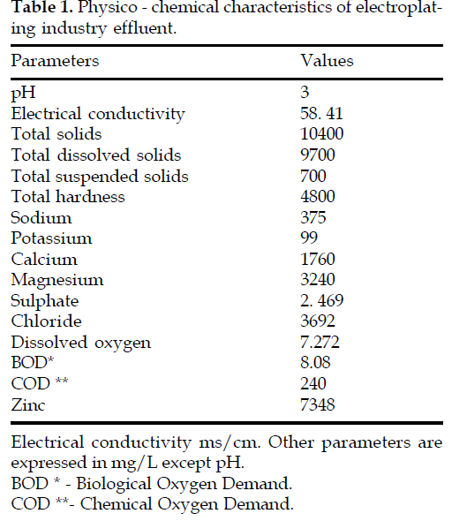
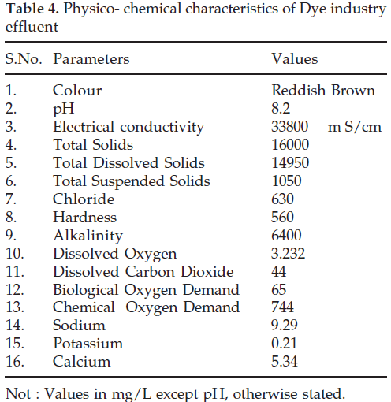
POLLUTION CHARACTERISTICS OF CERTAIN TYPICAL INDUSTRIES
PHYSICO – CHEMICAL CHARACTERISTICS
ELECTROPLATING INDUSTRY EFFLUENT
PHYSICO – CHEMICAL CHARACTERISTICS
DYE INDUSTRY EFFLUENT

Slide 21
THERMAL POLLUTION
Any form of the pollution that causes an increase in the temperature of the water.
The term thermal pollution is used to describe discharges that cause undesirable shifts in water temperature.
The disposal of cooling water from power plants, thermal wastes from industries, and wastewater treatment plant effluents into rivers, and canals, may cause thermal pollution.

Slide 22
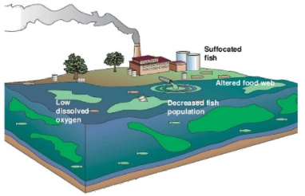

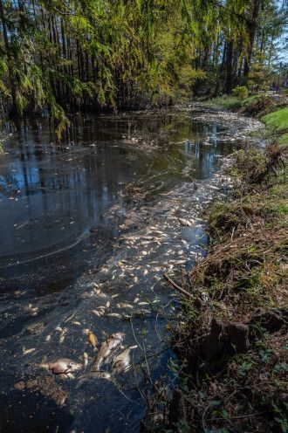
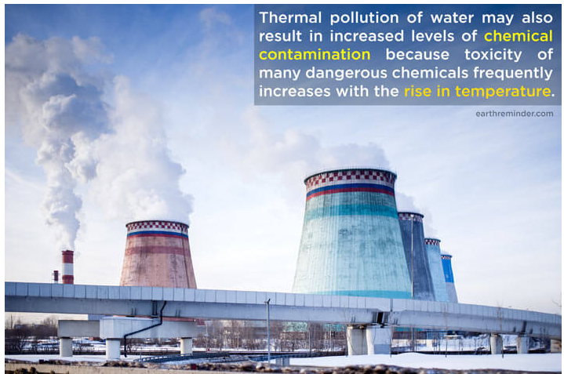
THERMAL POLLUTION AND ITS ADVERSE EFFECTS
INCREASING TEMPERATURE
KILLS FISH AND AQUATIC SPECIES

Slide 23
THERMAL POLLUTION AND ITS ADVERSE EFFECTS
Thermal pollution is defined as accumulation of unusable heat from human activities that disrupts the eco systems in the natural environment .
Thermal pollution is generally described in context to local problems, as on global basis, the change in heat is significant.
The most important anthropogenic sources of thermal pollution are industries that reject heat in the environment.
Nuclear power plants release much more heat which is estimated to be about 67%
The cooling of water which is normally 10-30 degree F warmer than nearby source, is the major cause of thermal water pollution
Aquatic ecosystems are more delicately balanced ecosystems which do not fluctuate much in temperature as do the land masses.

Slide 24
THERMAL POLLUTION AND ITS ADVERSE EFFECTS
Physical effects:
The temperature influences the viscosity , density, vapor pressure, surface tension, gas solubility and gas diffusion rates
Heated water has low density and spreads on the surface of water bodies causing them to stratify thermally. The stratification is a barrier to the oxygen penetration into the deeper layers. This is also disrupts the normal circulation patterns, the ecological consequences of which would be drastic, unpredictable and almost certainly deleterious.
At elevated temperatures, the sedimentation of suspended materials increases due to reduction in density and viscosity of water
Evaporation rate of water increases at high temperature
Warm water reduces its palatability
Once the receiving water becomes warm, it is not suitable further as cooling water because of the decrease in efficiency of heat transfer

Slide 25
THERMAL POLLUTION AND ITS ADVERSE EFFECTS
Chemical effects:
Chemistry of waters greatly depends upon the temperature.
Rate of chemical reactions normally increases with rise in temperature which is about two-fold with rise of every 10 degree Celsius.
BOD is also increased with temperature

Slide 26
THERMAL POLLUTION AND ITS ADVERSE EFFECTS
Chemical effects:
A variety of chemicals are added in the cooling of waters to prevent formation of biological growths, wood decay, corrosion,& scaling of the equipment.
Chlorination & addition of biocides are common practices to prevent the biological growths in the cooling towers & condensers.
The scales in the equipment are prevented by addition of polyphosphates or some other organics.
To check the corrosion, a number of chemicals such as sodium & potassium chromates, silicates, nitrites, Ferro cyanides, moly bates, salts of zinc, nickel, manganese & chromium, etc. are added to the cooling tower.

Slide 27
THERMAL POLLUTION AND ITS ADVERSE EFFECTS
Chemical effects:
In the normal operation, the dissolved solids level of cooling waters go on increasing because of continuous evaporation, which can not be tolerated after a certain range.
At this time, the whole circulating water is replaced by new water; the process is called ‘blow-down’.
The blow-down water often has a high solid content, besides additional chemicals which have been added to prevent biological growths, scales & corrosion. This blow-down water poses a serious threat of water pollution in receiving waters.

Slide 28
THERMAL POLLUTION AND ITS ADVERSE EFFECTS
Biological effects
As different species favours different temperatures, thermal pollution may lead to population decline of one specie and growth of the another. This results in shift of flora & fauna of water
Since, almost all proteins and enzymes are heat liable, temperature changes often play an important& highly regulatory role in the growth of aquatic organisms.
Behaviour, reproduction cycles, respiratory rates, digestive rates and many other physiological processes are normally temperature dependent.

Slide 29
THERMAL POLLUTION AND ITS ADVERSE EFFECTS
Biological effects
At high temperature, the dissolved oxygen decreases, while the metabolic rates of the organisms, requiring oxygen, increases, thus accentuating the stress.
At the same time the bacterial activity increases, further reducing oxygen supply. The water may rapidly become unfit for all but few anaerobic species.
High temperature works as barrier for oxygen penetration into cooler deep waters. The aerobic degradation gives way for the aerobic degradation, making the water more polluted. Further, in organically polluted waters, multiplication rate of bacteria increases with increase in temperature, especially where the food supply is in plenty.

Slide 30
THERMAL POLLUTION AND ITS ADVERSE EFFECTS
Biological effects
Fishes may starve at high temperature by becoming moribund & unable to capture food. The effect is further accentuated as the food requirement increases at the same time at higher temperature
The disease resistance in fishes lowers & pollutants become more toxic at elevated temperature. The species become more vulnerable to parasites.
Natural mitigation of fish is also affected due to formation of thermally polluted zones which act as barrier to the migration.

Slide 31
ROLE OF REGULATORY BODIES IN PROTECTION OF WATER BODIES-CONTROL MEASURES
In India, the monitoring of water quality on a national level is being carried out by Central Pollution Control Board (CPCB) under the following programmes.
1. Global Environmental Monitoring System (GEMS)
2. Monitoring of Indian National Aquatic Resources (MINARS)
3. National River Conservation Plan (NRCP)
Currently there are about 500 sampling stations of which more than 80% are for rivers and rest for groundwater, lakes and creeks.
A few stations, especially on rivers Ganga and Yamuna have been set up as “ Automatic Water Quality Monitoring Stations (AWQMS) which continuously monitor temperature, dissolved oxygen, pH, Conductivity and turbidity of water.

Slide 32
ROLE OF REGULATORY BODIES IN PROTECTION OF WATER BODIES-CONTROL MEASURES
Central Pollution Control Board, jointly with Department of Ocean Development and Department of Environment, has also established a network of 173 stations over the entire coastline of the country at varying distances from the coast to assess the quality of coastal and estuarine water.
A monitoring programme called “ Coastal Ocean Monitoring and Prediction System (COMAPS) was also carried out during 1991-1992 by the Department of Ocean Development in cooperation with CPCB.
It involved monitoring of coastal sea up to a distance of 25 km from the shoreline in a stretch of about 400 km between Bangladesh and Paradeep Port in Orissa.

Slide 33
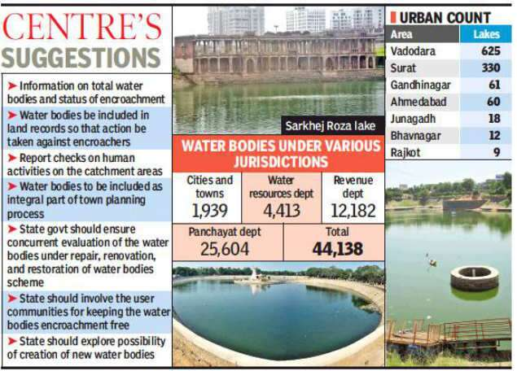
ROLE OF REGULATORY BODIES IN PROTECTION OF WATER BODIES-CONTROL MEASURES

Slide 34
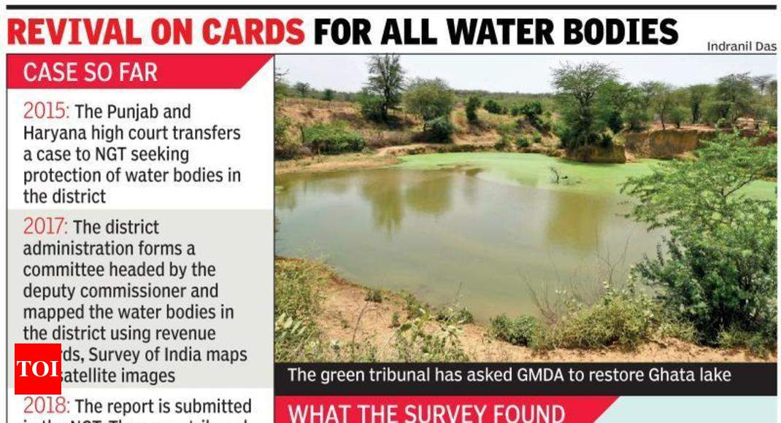
ROLE OF REGULATORY BODIES IN PROTECTION OF WATER BODIES-CONTROL MEASURES

Slide 35
ROLE OF REGULATORY BODIES IN PROTECTION OF WATER BODIES-CONTROL MEASURES
Conservation of river corridors, water bodies and infrastructure needs to be undertaken.
Encroachments and diversion of water bodies and drainage channels must not be allowed.
Pollution of sources of water and water bodies should not be allowed.
Legally empowered dam safety services need to be ensured.

Slide 36
ROLE OF REGULATORY BODIES IN PROTECTION OF WATER BODIES-CONTROL MEASURES
River Action Plan:
CPCB (Central Pollution Control Board) identified polluted water bodies, which leads to formulation of action plan for restoration of the water body.
Based on CPCB’s recommendations, Ganga action was launched in 1986 to restore the Ganga by interception, diversion and treatment of waste water from 27 cities/towns located along the river.
Based on the experience gained during implementation of the Ganga Action Plan, Govt of India extends river cleaning program to other rivers and lakes.

Slide 37


ROLE OF REGULATORY BODIES IN PROTECTION OF WATER BODIES-CONTROL MEASURES

Slide 38
THE WATER (PREVENTION AND CONTROL OF POLLUTION) ACT, 1974
An Act to provide for the prevention and control of water pollution and the maintaining or restoring of wholesomeness of water.
Regulatory bodies:
Constitution of Central board
Constitution of state board
Functions of Central board:
Subject to the provisions of this Act, the main function of the Central Board shall be to promote cleanliness of streams and wells in different areas of the States.
Advise the Central Government on any matter concerning the prevention and control of water pollution;
Co-ordinate the activities of the State Boards and resolve disputes among them;

Slide 39
THE WATER (PREVENTION AND CONTROL OF POLLUTION) ACT, 1974
Provide technical assistance and guidance to the State Boards, carry out and sponsor investigations and research relating to problems of water pollution and prevention, control or abatement of water pollution;
Plan and organise the training of persons engaged or to be engaged in programmes for the prevention, control or abatement of water pollution on such terms and conditions as the Central Board may specify;
Organise through mass media a comprehensive programme regarding the prevention and control of water pollution.
Collect, compile and publish technical and statistical data relating to water pollution and the measures devised for its effective prevention and control and prepare manuals, codes or guides relating to treatment and disposal of sewage and trade effluents and disseminate information connected therewith;

Slide 40
THE WATER (PREVENTION AND CONTROL OF POLLUTION) ACT, 1974
Lay down, modify in consultation with the State Government concerned, the standards for a stream or well:
Plan and cause to be executed a nation-wide programme for the prevention, control or abatement of water pollution;
The Board may establish or recognise a laboratory or laboratories to enable the Board to perform its functions under this section efficiently, including the analysis of samples of water from any stream or well or of samples of any sewage or trade effluents.

Slide 41
THE WATER (PREVENTION AND CONTROL OF POLLUTION) ACT, 1974
Functions of State board:
(1) Subject to the provisions of this Act, the functions of a State Board shall be –
(a) to plan a comprehensive programme for the prevention, control or abatement of pollution of streams and wells in the State and to secure the execution thereof;
(b) to advise the State Government on any matter concerning the prevention, control or abatement of water pollution;
(c) to collect and disseminate information relating to water pollution and the prevention, control or abatement thereof;

Slide 42
THE WATER (PREVENTION AND CONTROL OF POLLUTION) ACT, 1974
Functions of State board:
(d) to encourage, conduct and participate in investigations and research relating to problems of water pollution and prevention, control or abatement of water pollution;
(e) to collaborate with the Central Board in organising the training of persons engaged or to be engaged in programmes relating to prevention, control or abatement of water pollution and to organise mass education programmes relating thereto;

Slide 43
THE WATER (PREVENTION AND CONTROL OF POLLUTION) ACT, 1974
Functions of State board:
(f) to inspect sewage or trade effluents, works and plants for the treatment of sewage and trade effluents and to review plans, specifications or other data relating to plants set up for the treatment of water, works for the purification thereof and the system for the disposal of sewage or trade effluents or in connection with the grant of any consent as required by this Act;
(g) lay down, modify or annul effluent standards for the sewage and trade effluents and for the quality of receiving waters (not being water in an inter-State stream) resulting from the discharge of effluents and to classify waters of the State;

Slide 44
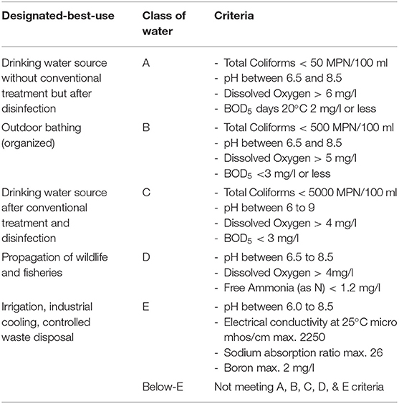
DISCHARGE STANDARDS FOR RIVER AND STREAM

Slide 45
SELF PURIFICATION OF STREAM
When waste water is discharged into the river or stream, the BOD of mix increases initially and DO levels starts falling.
As river water travels further, BOD gradually reduces and DO increases and reaches its saturation level.
Thus river, purified on its own.
This is known as self purification of stream.
Actions involved in self purification of streams:
Dilution
Dispersion due to current
Sedimentation
Oxidation
Reduction
Temperature
Sunlight

Slide 46
SELF PURIFICATION OF STREAM
Dilution and Dispersion:
When the perishable organic matter is discharged into river-stream, it gets rapidly dispersed and diluted.
This results in lowering of waste concentration and thus reduces the potential nuisance of sewage.
Sedimentation:
The settleable solids present in effluents will settle down into the river bed, thus helping in the self purification process.
Oxidation:
The oxidation of the organic matter present in the sewage effluent, will start as soon as the sewage outfalls into the river water containing dissolved oxygen.
The deficiency of oxygen would be filled up by the atmospheric oxygen

Slide 47
SELF PURIFICATION OF STREAM
Reduction:
Reduction occurs due to hydrolysis of organic matter settled at the bottom either chemically or biologically
Anaerobic bacteria will help in splitting the complex organic constituents of sewage in liquids and gases, thus paving the for their ultimate stabilization by oxidation.
Sunlight:
The Sun light has a bleaching and stabilizing effect of bacteria.
Algae produces oxygen in the presence of sunlight due to photosynthesis
Therefore sunlight helps in purification of stream by adding oxygen through photosynthesis.

Slide 48
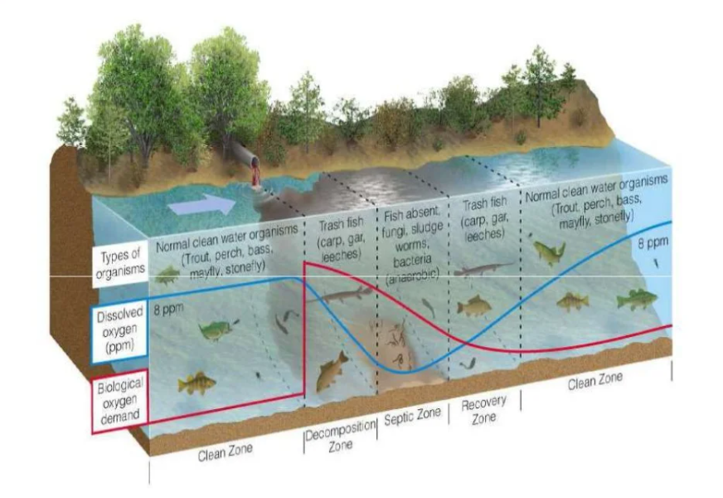
SELF PURIFICATION OF STREAM

Slide 49
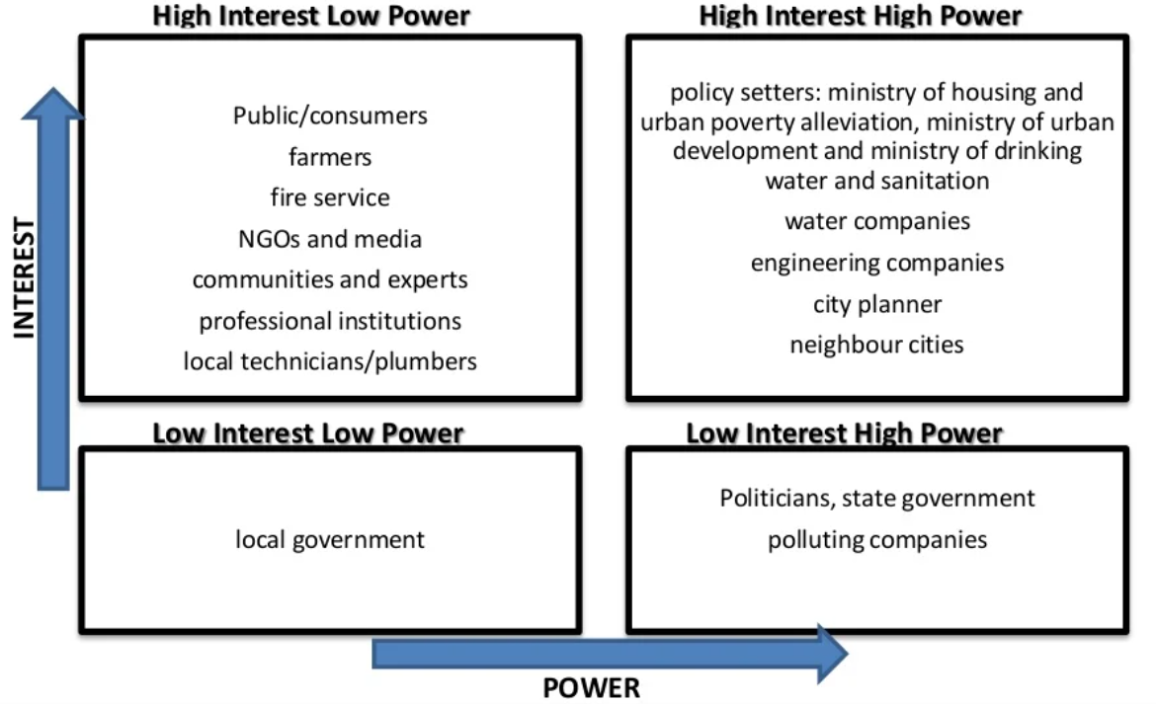
ROLE OF STAKEHOLDERS IN PROTECTION OF WATER BODIES
Primary stakeholders:
People, groups and institutions affected positively (beneficiaries) or negatively (involuntarily resettled) by the proposed program.
Secondary stakeholders:
People, groups and institutions that are important intermediaries in the program delivery process (e.g government line agencies, NGOs)

Slide 50
WATER QUALITY MONITORING
The reliable assessment of water quality through water quality monitoring programs (WQMPs) is crucial in order for decision-makers to understand, interpret and use this information in support of their management activities aiming at protecting the resource.

Slide 51
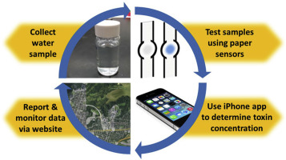
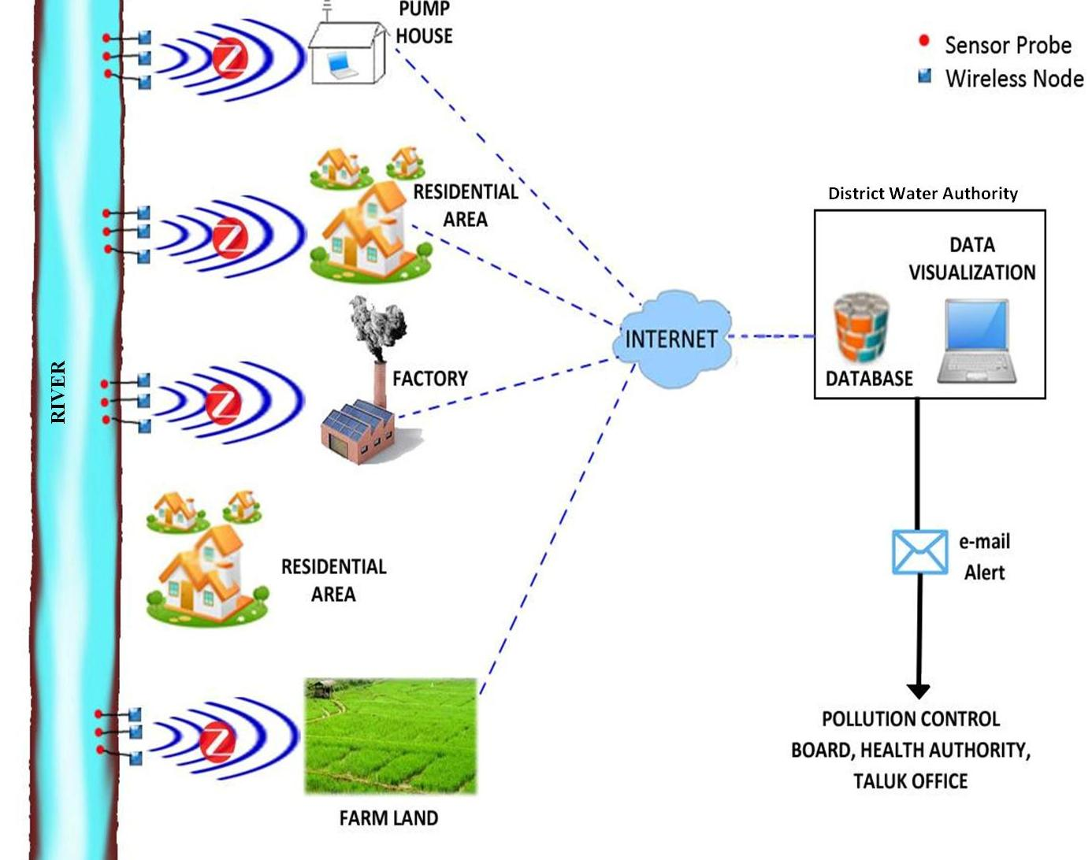
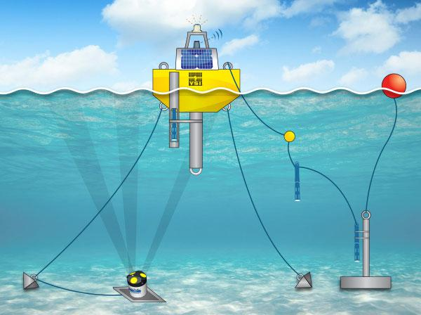
WATER QUALITY MONITORING AND ITS PURPOSE
pH Sensors, DO Sensors,
Temperature Sensors, Turbidity Sensors

Slide 52
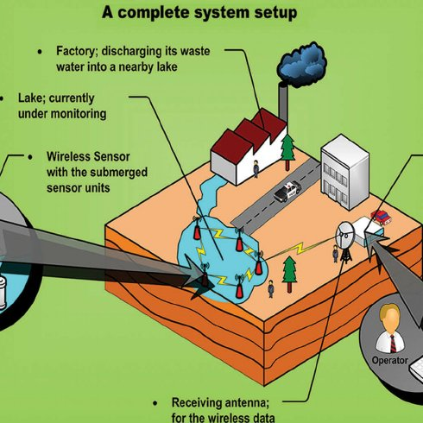
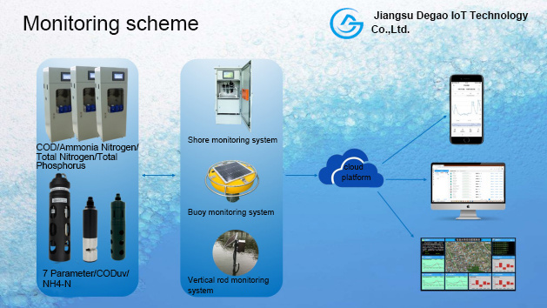
WATER QUALITY MONITORING AND ITS PURPOSE

Slide 53
WATER QUALITY MONITORING AND ITS PURPOSE
Water is an important natural resource which needs constant quality monitoring for ensuring its safe use. Traditionally, the water quality detection has been carried out manually wherein the water samples are collected and taken to the laboratories for analysis. Since these methods fail to deliver real time data,
Hence, propose a river water quality monitoring system based on wireless sensor network which helps in continuous and remote monitoring of the water quality data in India.
The system architecture is based on hierarchical topology in which the monitoring scenario is divided into four general areas; each forming a cluster comprising of several wireless sensor nodes responsible for sensing, data collection & processing and communication.

Slide 54
WATER QUALITY MONITORING AND ITS PURPOSE
The wireless sensor node in the system is designed for monitoring three of the main parameters that affect the quality of water, i.e. pH, conductivity and temperature of water.
The proposed sensor node design mainly comprises of a signal conditioning module, processing module which is implemented using PIC microcontroller and wireless communication module consisting of Zigbee radio.
So the sensed parameter values will be wirelessly transmitted in real time to the base station using Zigbee communication after the required signal conditioning and processing techniques.
This system provides an energy efficient and low cost sensor unit for monitoring water quality through the use of inexpensive, low power devices for the hardware design.

Slide 55
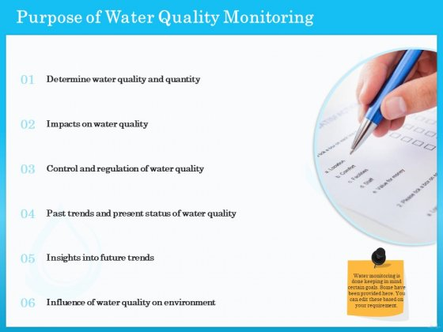
WATER QUALITY MONITORING AND ITS PURPOSE

Slide 56
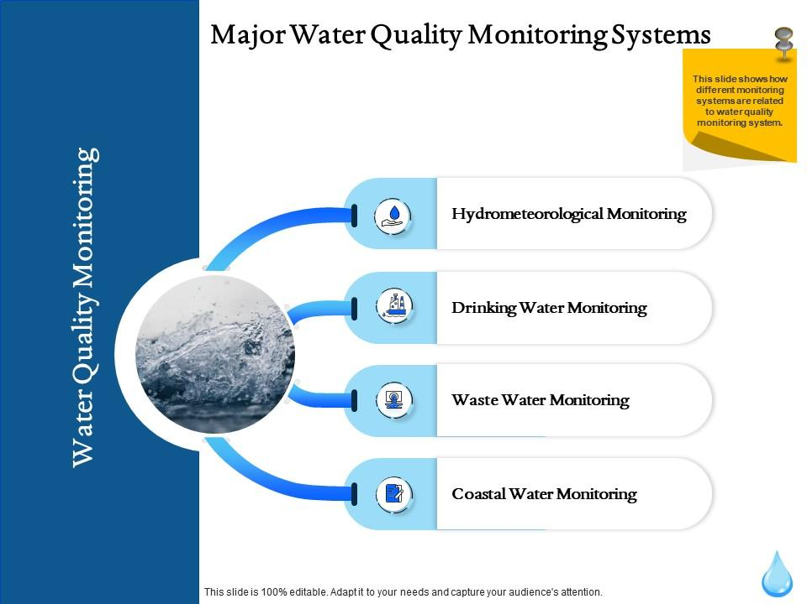
WATER QUALITY MONITORING AND ITS PURPOSE

Slide 57
WATER QUALITY MONITORING AND ITS PURPOSE
To identify whether waters are meeting designated uses:
All states have established specific criteria (limits on pollutants) identifying what concentrations of chemical pollutants are allowable in their waters. When chemical pollutants exceed maximum or minimum allowable concentrations, waters might no longer be able to support the beneficial uses such as fishing, swimming, and drinking for which they have been designated.
Designated uses and the specific criteria that protect them (along with antidegradation statements say waters should not be allowed to deteriorate below existing or anticipated uses) together form water quality standards.

Slide 58
WATER QUALITY MONITORING AND ITS PURPOSE
To identify whether waters are meeting designated uses:
State water quality professionals assess water quality by comparing the concentrations of chemical pollutants found in streams to the criteria in the state's standards, and so judge whether streams are meeting their designated uses.
Water quality monitoring, however, might be inadequate for determining whether aquatic life uses are being met in a stream. While some constituents (such as dissolved oxygen and temperature) are important to maintaining healthy fish and aquatic insect populations, other factors, such as the physical structure of the stream and the condition of the habitat, play an equal or greater role. Biological monitoring methods are generally better suited to determining whether aquatic life is supported.

Slide 59
WATER QUALITY MONITORING AND ITS PURPOSE
To identify specific pollutants and sources of pollution:
Water quality monitoring helps link sources of pollution to a stream quality problem because it identifies specific problem pollutants. Since certain activities tend to generate certain pollutants (e.g., bacteria and nutrients are more likely to come from an animal feedlot than an automotive repair shop), a tentative link might be made that would warrant further investigation or monitoring.
To determine trends:
Chemical constituents that are properly monitored (i.e., consistent time of day and on a regular basis, using consistent methods) can be analysed for trends over time.
To screen for impairment:
Finding excessive levels of one or more chemical constituents can serve as an early warning "screen" of potential pollution problems.

Slide 60
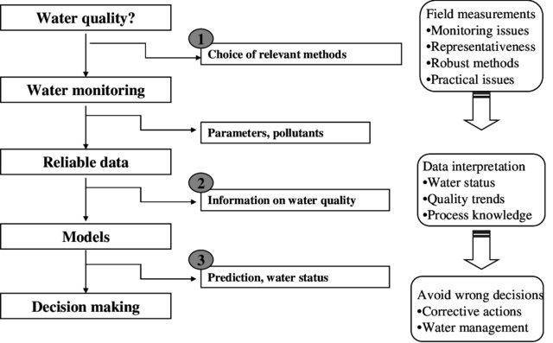
WATER QUALITY MONITROING STRATEGY

Slide 61
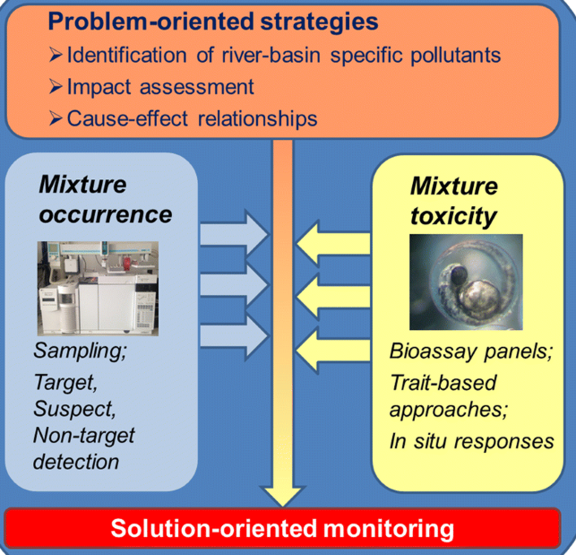
WATER QUALITY MONITROING STRATEGY

Slide 62
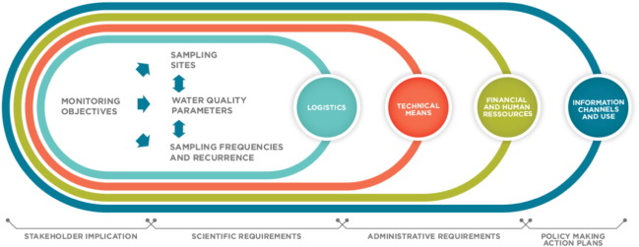
WATER QUALITY MONITROING STRATEGY

Slide 63
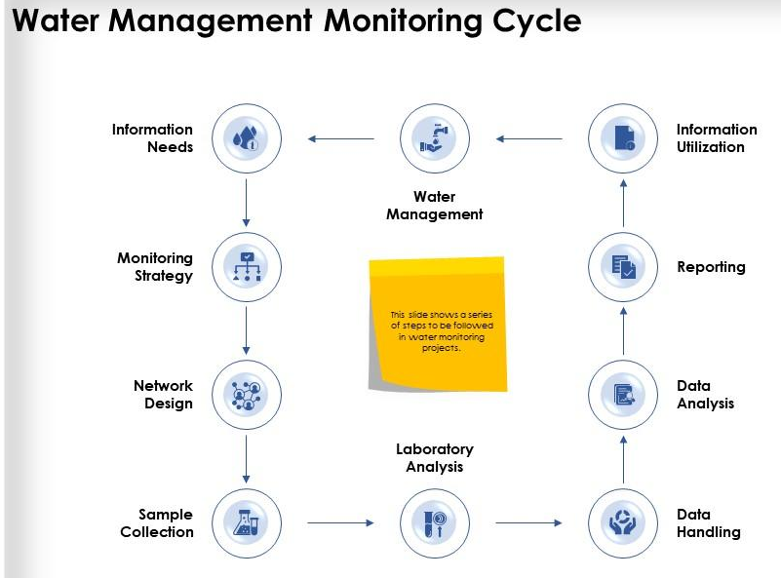
WATER QUALITY MONITROING STRATEGY

Slide 64
STEPS INVOLVED IN WATER QUALITY MONITORING
Setting water quality monitoring objectives
Assessment of resources availability
Facilities, Manpower
Reconnaissance survey
Map of the area, Potential pollution sources, Hydrological information
Network design
Selection of sampling location, Optimum number of locations, frequency of sampling, parameters to be measured
Sampling
Representative sampling, Field testing, Sample preservation and transport
Laboratory work
Laboratory procedures, Physical chemical analysis
Microbiological and biological analysis
Data management
Statistical analysis, Presentation, Interpretation and Reporting
Quality assurance
Production of reliable data, Quality control

Slide 65
PARAMETERS AND FREQUENCY OF MONITORING
On routine basis, a combination of general parameters, nutrients, oxygen consuming substances and major ions should be analysed at all stations. Depending upon the industrial activities and anticipated at the upstream of the sampling station other parameters like micro-pollutants, pesticides or other site specific variables may be included at lower frequency. Such stations need to be identified.
A list of parameters to be considered for analysis and frequency of sampling is provided in the “Protocol for Water Quality Monitoring” notified by Govt of India.
It was also emphasized that biological monitoring should form an important part of our water quality monitoring programme due to its inherent advantages. The SPCBs/PCCs agreed to initiate such exercise initially at limited stations.
Sediment needs to be analysed for micro pollutant in some stretches as most of micro pollutants are associated with sediment. This should form part of monitoring programme.

Slide 66
PARAMETERS AND FREQUENCY OF MONITORING
On routine basis, a combination of general parameters, nutrients, oxygen consuming substances and major ions should be analysed at all stations. Depending upon the industrial activities and anticipated at the upstream of the sampling station other parameters like micro-pollutants, pesticides or other site specific variables may be included at lower frequency. Such stations need to be identified.
A list of parameters to be considered for analysis and frequency of sampling is provided in the “Protocol for Water Quality Monitoring” notified by Govt of India.
It was also emphasized that biological monitoring should form an important part of our water quality monitoring programme due to its inherent advantages. The SPCBs/PCCs agreed to initiate such exercise initially at limited stations.
Sediment needs to be analysed for micro pollutant in some stretches as most of micro pollutants are associated with sediment. This should form part of monitoring programme.

Slide 67
PARAMETERS AND FREQUENCY OF MONITORING
The sampling frequency is governed by the level of variation in water quality of a water body. If variations are large in a short duration of time, a larger frequency is required to cover such variations. On the other hand, if there is no significant variation in water quality, frequent collection of sample is not required.
The water quality variations could be of two types i.e. random and cyclic or seasonal. In case of random variations e.g. due to sudden rainfall in the catchment or sudden release of water from the dam etc., increased frequency may not help much as such variations are highly unpredictable.
Thus, within the available resources it is not cost effective to cover such variations. In case of the water bodies having cyclic variations more frequently, sampling on monthly basis is justified. But for all those water bodies having stable water quality round the year, monthly sampling is not justified.

Slide 68
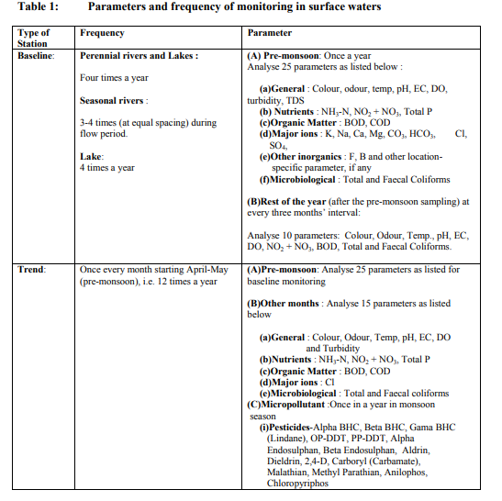
PARAMETERS AND FREQUENCY OF MONITORING

Slide 69
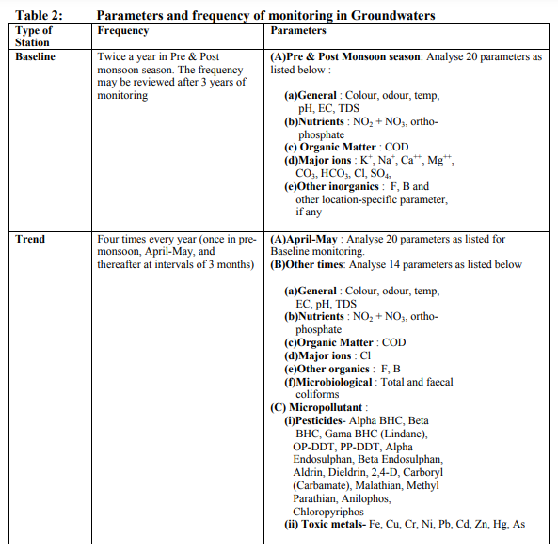
PARAMETERS AND FREQUENCY OF MONITORING

Slide 70
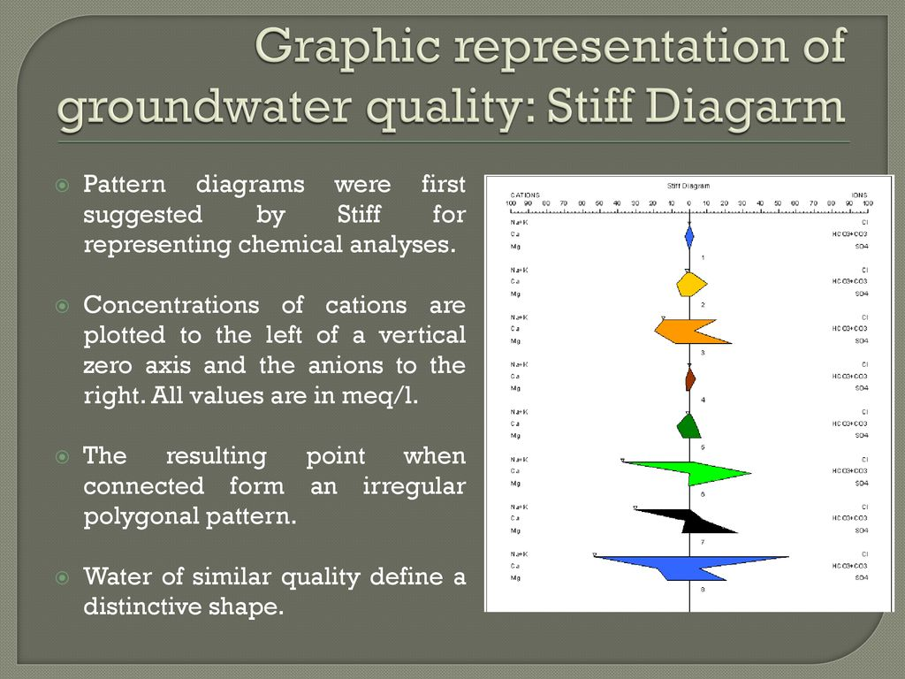
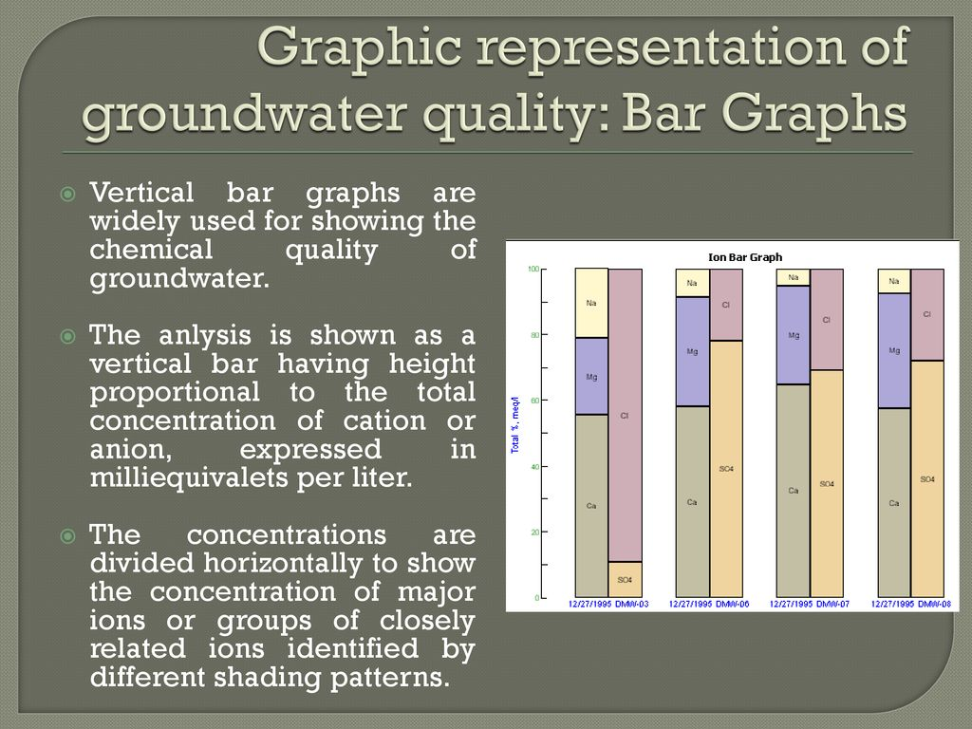
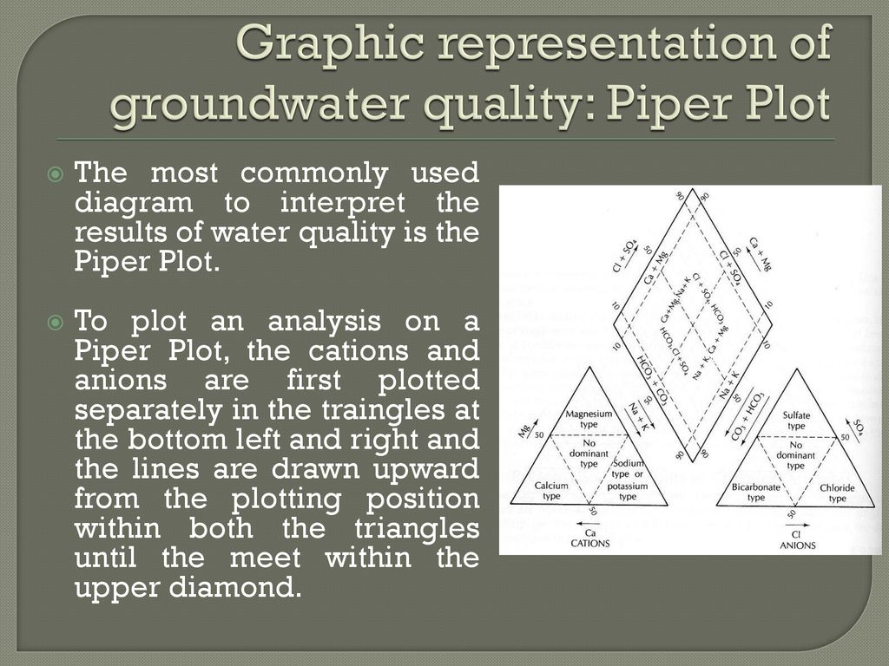
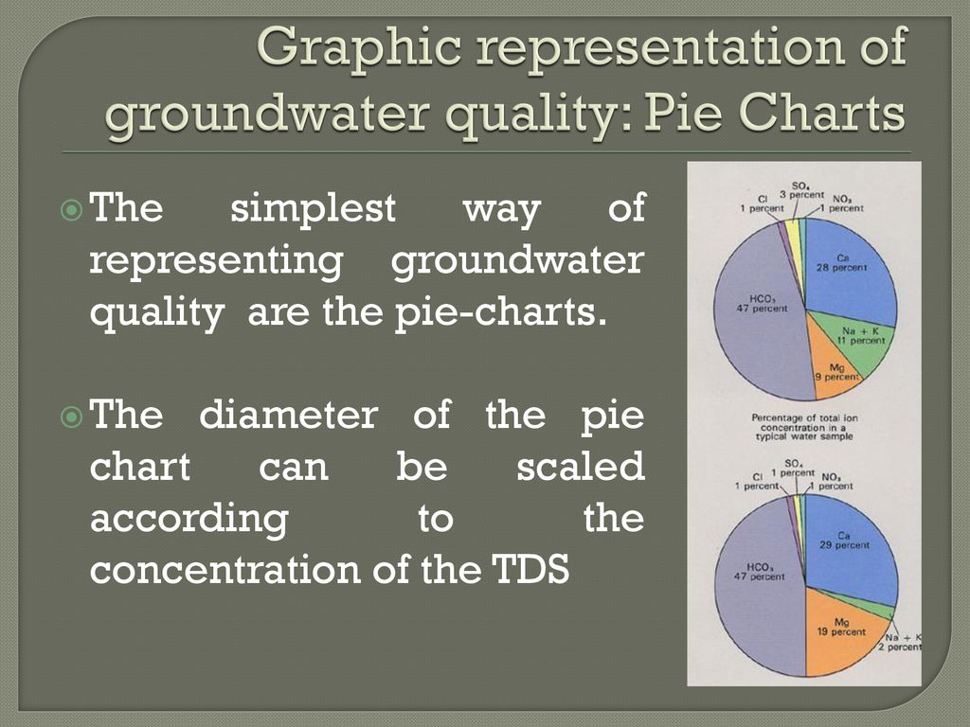
GRAPHICAL REPRESENTATION OF WATER QUALITY

Slide 71
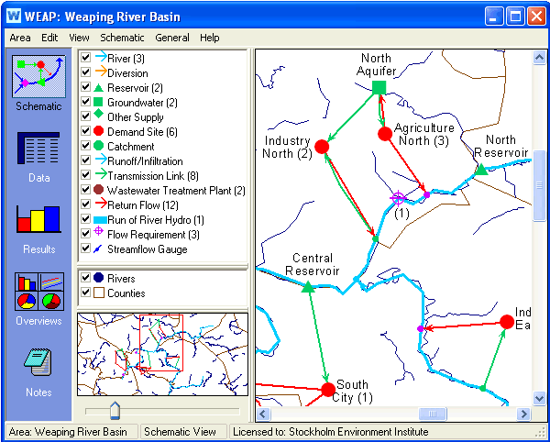
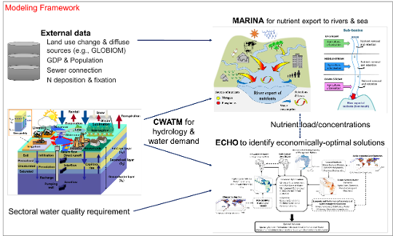
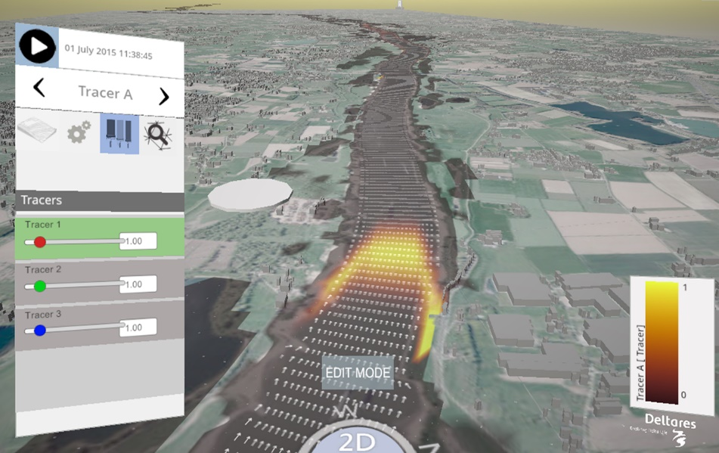
SOFTWARES USED IN WATER QUALITY MODELLING
WATER EVALUATION AND PLANNING
MARINA MODEL
DELFT 3D

